Slide 1


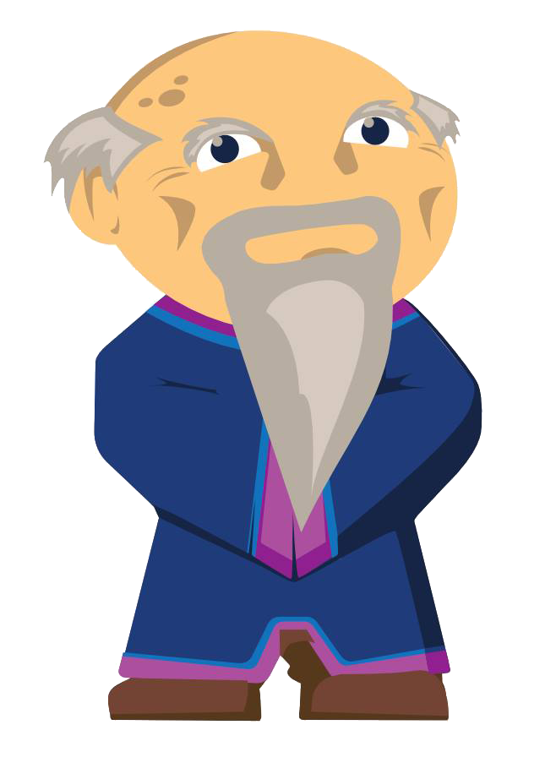

Introducing Scratch & Game Design
1.1 Engage

Slide 2
What is a computer?
What are examples of computers?
How do these computers know what to do?

Slide 3

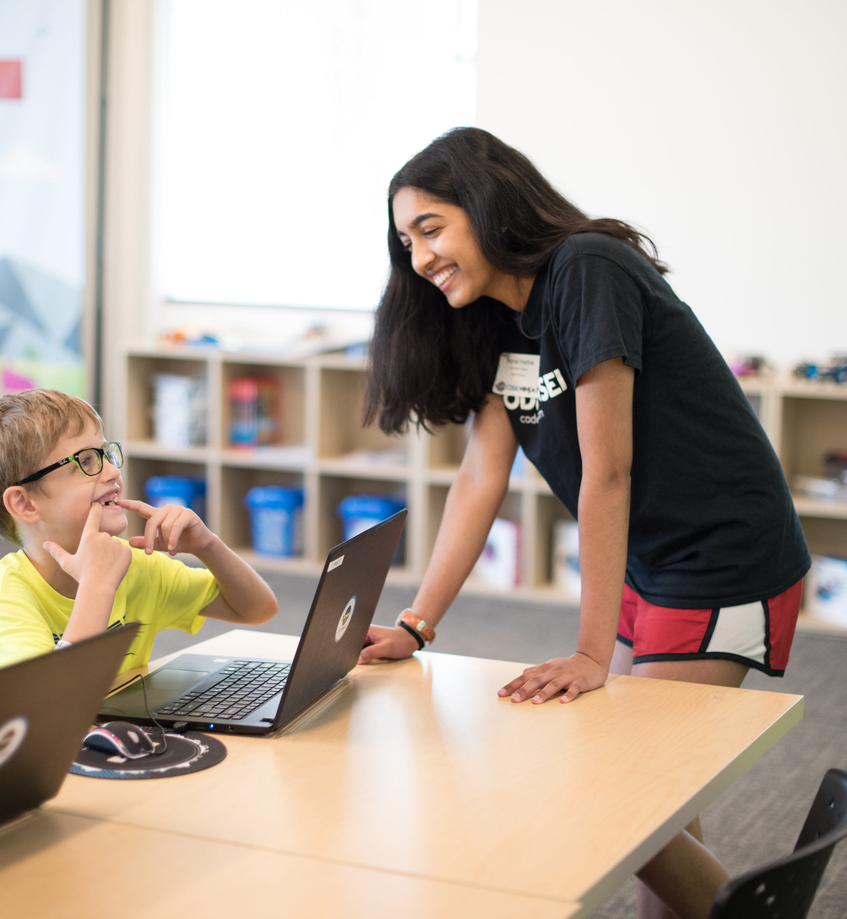
Computer
Computers are machines we give instructions. We could give computer instructions in different programming languages. Scratch is a programing language we will be learning

Slide 4

Tell us about your favorite games

Slide 5

Is Tic Tac Toe fun?

Slide 6
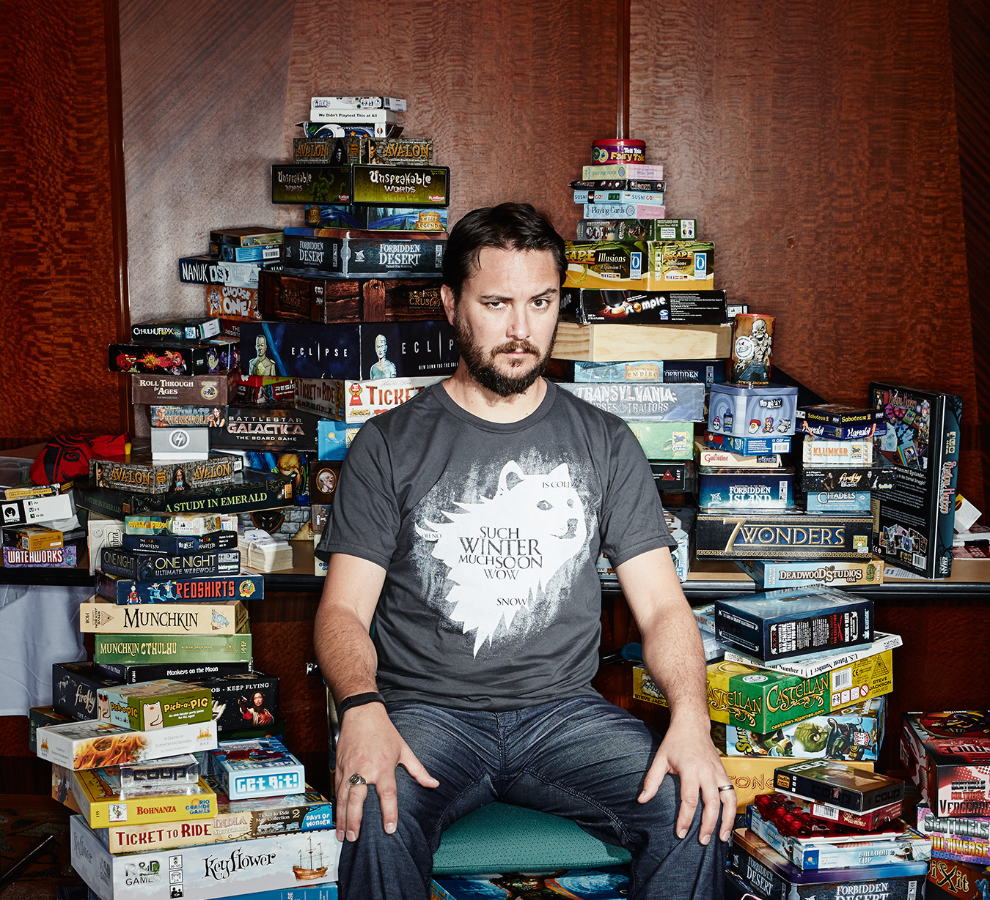
Do you play any board games?

Slide 7
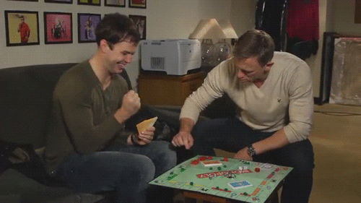
Did you lose interest in some of the games?

Slide 8
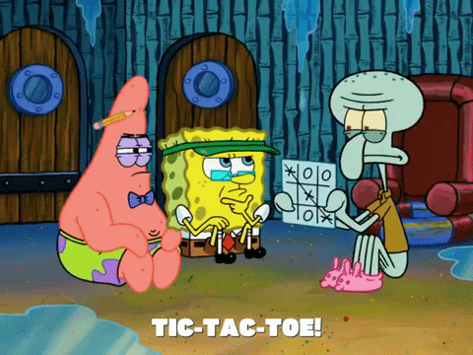
Lets play

Slide 9
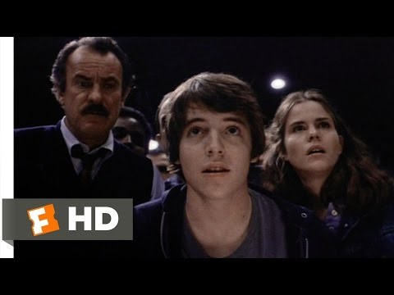

Slide 10
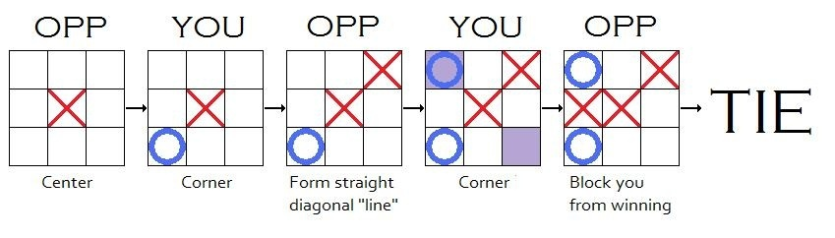
Algorithm for not loosing

Slide 11
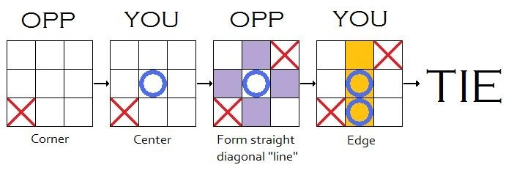
Algorithm for not loosing

Slide 12
Lets play

Slide 13
Why are some games fun and other games boring?
Why do some games start getting boring after a while, and other games stay fun for a long time?”

